Slide 1
De-Identification: Ground Truth Trajectories
Presented By: Anthony, Jon, Josh & Shojib
Notes:
Introduce the group and which paper

Slide 2
Summary

Slide 3
Researchers from Virginia Tech and China Telecom Beijing obtained data from Chinese ISPs and Ground-Truth trajectory data sets from popular social media and check-in websites
The containing datasets have a little over 2 million users, ranging from various large social networks for the most part, and also various check-in services.
The datasets were on the same population, thus giving researches an opportunity to analyze the true effectiveness of the 7 algorithms and how they can be utilized in De-anonymizing users by overlapping datasets (linkage attacks).
The United States has tried to repeal internet privacy rules, allowing people to be tracked on much more precise level.
Notes:
Shojib
This repeal would allow for the ability to track people at a much more precise level. Effectively allowing data brokers (advertisers) to have a much more personalized marketing campaign per each user. This study as well as studies before this one have tried to answer the question of how much PII can be given away by allowing ISPs to track human mobility. Methodology of researchers consists of using human mobility trajectories from ISPs as well as the data from Social Network Weibo, and Check-in service Dianping.

Slide 4

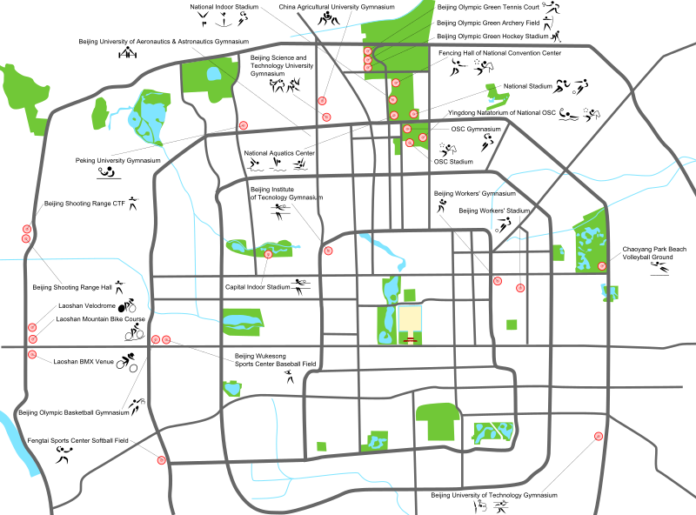
Data Sets & Algorithms
4
2
3
1
5
1
s
3
2
t
6
Notes:
Hello, this is Jon. We’re now going to explore the nature of the trajectory data central to our paper. We will then move on to some of the algorithms used in a deanonymizaiton attack. Let’s start with an intuitive example of how this data occurs in the real world, and later shift to the more formalized strucutres of our authors’ paper.
Imagine an individual, let’s call him Bob, has entered a city on vacation and is visiting a number of locations. As Bob travels to each destination his phone is broadcasting geospatial information at various intervals to his Cellular Service Provider. For Bob’s security, his provider stores this data without his identifying information. This data would have Bob’s alias, and the latitude/longitude pairs for each time period that was logged. The data would look as such [display data structure]
As Bob toured the city he periodically shared his vacation experience on social media. His posts contain timestamps and reveal the sites he has visited, which can easily be associated with lat/long pairs.
The question our authors seek to address is whether an adversary with access to the cellular provider’s location trace data can distinguish Bob’s location trace from all the other locations traces by associating it with his external check-in data.
Next Slide please

Slide 5
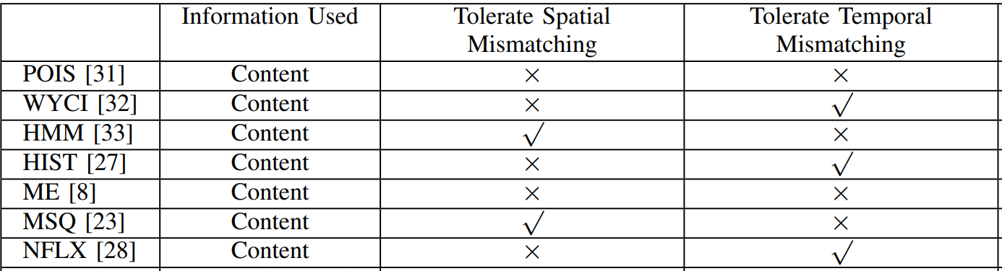
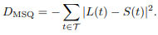
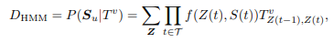
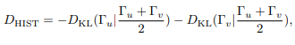
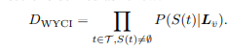
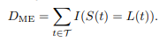
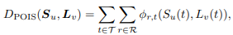
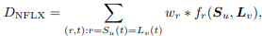
Data Sets & Algorithms Cont.
Bloc 1
Bloc 2
Bloc 3
4
2
Similarity Scores:
Gap in space or time
3
1
5
Bloc 4
Block 5
Bloc 6
1
s
3
2
t
6
Notes:
The authors point out that most research on deanonymizing location traces has been on small data sets or simulated data. When this is the case, the check-in data and GPS data frequently have precisely matching time and location measurements. In reality, there are a number of things which can cause misalignment of the spatial or temporal figures, such as: poor GPS signal, check-in data being registered after-the-fact, or differences in the duration of mechanisms for recording the data. If we are to accurately measure the efficacy of deanonymization techniques these real world discrepancies must be considered.
One straightforward method of addressing these gaps is to group together the nearby instances of the location traces into blocs. For example, any points within a certain grid may be considered the same location, or any timestamps within a certain range of time could be considered identical. This grouping may eliminate some of the noise present in real-life data, however, it is difficult to know for certain what the appropriate size of these bins should be; too granular of bins may not successfully group instances together, whereas too broad of a grouping may erroneous associated records or diminish the utility of the data.
Using a large set of matched ISP and check-in data, the authors go on to explore several algorithms for deanonymization, and identify which are capable of handling spatial or temporal mismatches beyond merely grouping elements. While the methods each of these algorithms deploys are quite different, they share a common goal of calculating a “similarity score,” which indexes how similar each external trace is to the possible locations traces. The authors note that none of the algorithms handle both spatial and temporal mismatches, and go on to suggest a mixed model which we will now review. Next slide please.

Slide 6
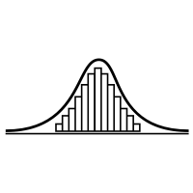
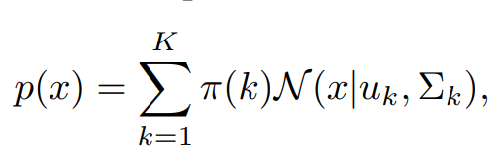
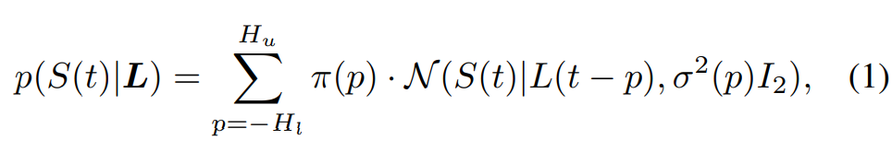
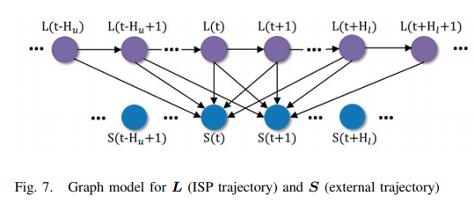
Gaussian Mixed Model & Markov
Temporal Mismatches:
-3
-2
-1
0
1
2
3
S
Less likely
Gap
Similarity Score:
Most likely
Notes:
Describe the use of each of the different data sets and how their research differs from other papers (ground-truth)
Similarity Scores & Ranking, how are the attack methods being “graded”
Jon describes algorithms & author’s GM
Please insert a brief summary of the data set and how we created it.
PLEASE DON’T TALK ABOUT HOW WE GOT THEM WORKING, THAT IS THE NEXT SLIDE
The author’s mixed model combines a Gaussian model to handle spatial/temporal mismatches, and a Markov model to match the external trace data to their ISP data for deanonymization.
The Gaussian portion of the model is used to correct spatial/temporal mismatches. In effect, you can think of the model as looking at each of the points from the external trace data, comparing it to the points in the location trace data, and collecting the observed gaps between these points. The collection becomes a probability distribution where larger gaps are identified as less likely to be the correct points to pair, and the most probable pairing is applied to the candidate external trace instance. [fade the outliers, label most and less likely]
Once adjustments have been made to correct spatial/temporal mismatches, a Markov model is applied which compares each chain of external trace data against each of the candidate ISP traces and calculates a similarity score. Once these scores have been calculated, the location trace with the highest ranking similarity score is assumed to be the correct match.
Although the authors did an excellent job summarizing the existing literature, identifying the gaps between theory and practice in the domain, and explaining their model and its benefits, we found their work to be particularly difficult to replicate. I will now turn it over to Anthony to share some of the problems we encountered.

Slide 7
Problems
One of the biggest problems with our research project was that the dataset they used, is not available to other researchers. This means that it is hard to be falsifiable, therefore hard to verify.
The second problem we encountered was the lack of detail technical instructions as to how to implement their code/sample dataset.
Finally updating their code from Python 2 to Python 3.
Notes:
Anthony describes the issues with getting the GM model to work
Updating Code

Slide 8
Solutions
We were able to get their algorithms running on our own test data.
We were able to make a dataset to test the algorithms against.
Used a list of cities in Michigan (not including UP)
Randomly generated location traces from that list of cities for 100 users
Number of traces for each user is random for 1 to 10 cities.
External trajectory is randomly generated for a location in Michigan.
Notes:
Josh on how he made the data set

Slide 9
Demo:
Notes:
Document/file formats
How we created the data set
Results of algorithms
Walk through high-level of the actual code for GM

Slide 10
End Results
In the end we achieved variable results in comparison to the study they performed.
This leads us to many questions:
Was our dataset bad (fruit of the poisoned tree)?
Was our implementation of the algorithm incorrect?
Notes:
This is code output explained

Slide 11
Conclusion:
We agree their GMM algorithm outperforms the HMM and HIST algorithms
The authors should have provided a more robust data set for assessment beyond Ground-truths data
Suggestions for improvement: contact an ISP and Research board and conduct this as an experiment with consent, so the data could be shared and confirmed (basis of science)
Notes:
Anthony closes out conclusion (our findings support theirs, but would need further testing)
We agree their GMM outperforms HMM and HIST
Authors should have provided a more robust data set for assessment beyond Ground-truths data
Suggestions for improvement: contact an ISP and Research board and conduct this as an experiment with consent, so the data could be shared and confirmed (basis of science)

Slide 12
Links To Original Work
https://gangw.cs.illinois.edu/ndss18.pdf

Slide 13
Links To Our Work
Source for list of US cities: https://simplemaps.com/data/us-cities
Jon, add public version of project Github

Slide 14
Email Queries To:
apicciut@umich.edu
jmbertin@umich.edu
jfust@umich.edu
shojib@umich.edu

